Slide 1
The Floods of 2012
MnDOT District 1 - Duluth
Duane Hill, District Engineer
218-725-2704
duane.hill@state.mn.us

Slide 2
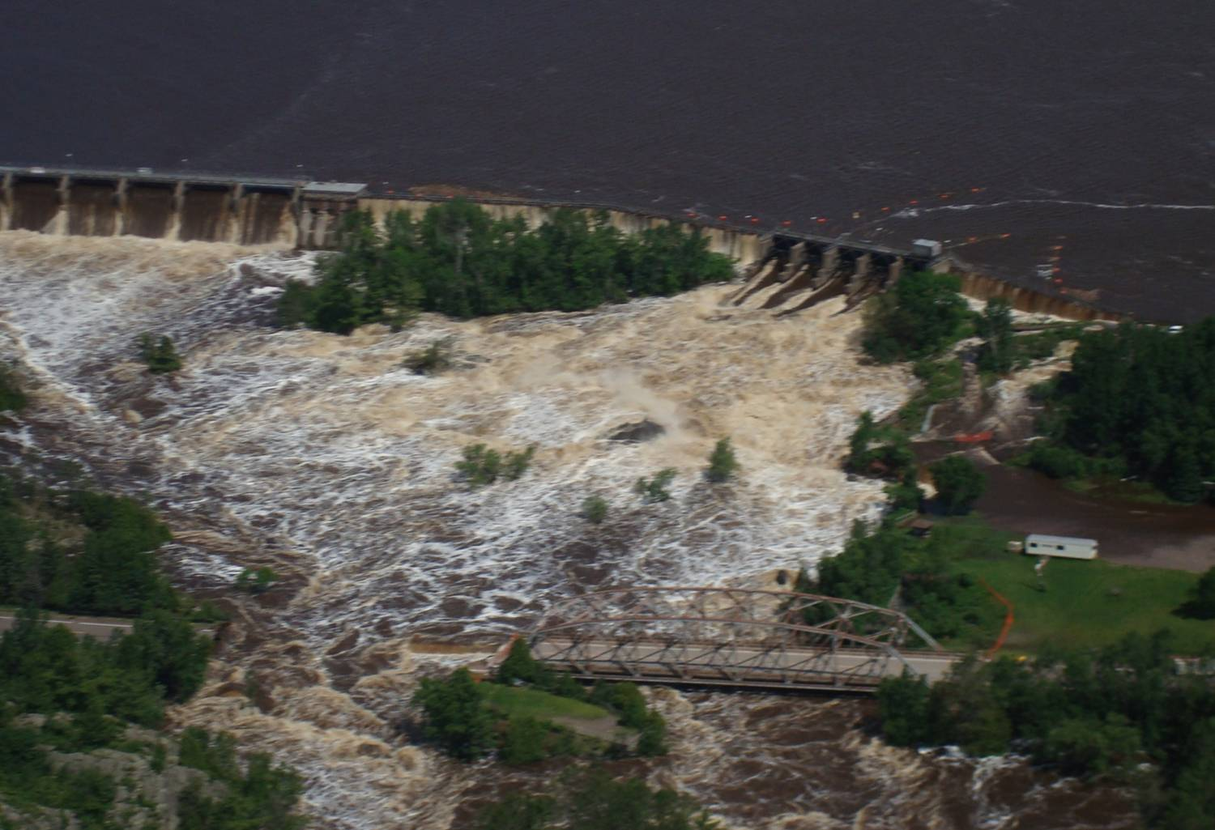
Overview:
Describe MnDOT Major Impacts from the Event
Describe MnDOT Response
Describe Completed and Remaining Work

Slide 3
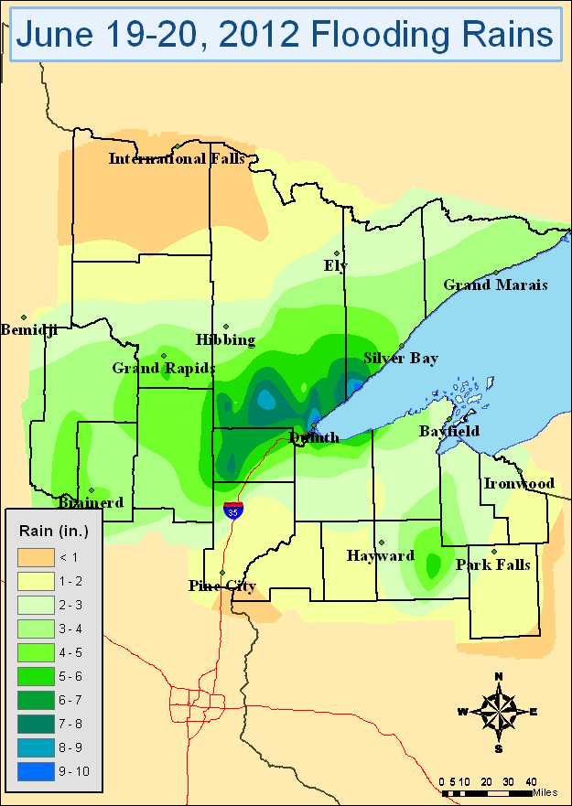
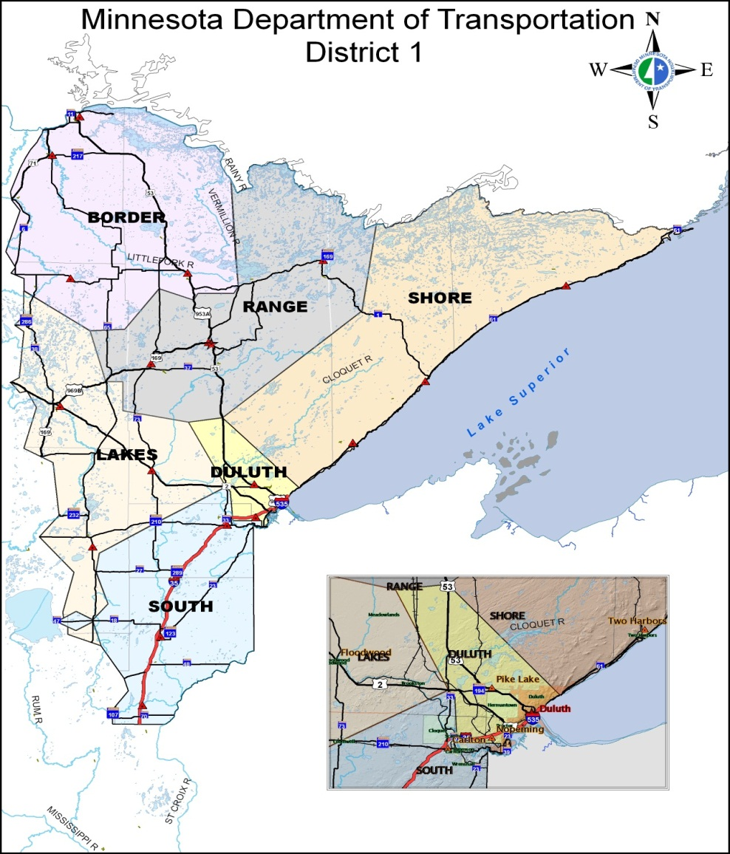
What happened?

Slide 4
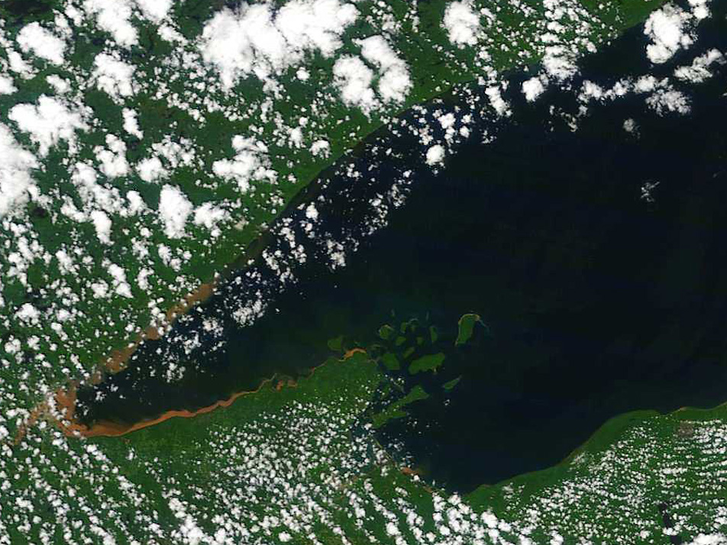
Torrential rain and flooding turned the southwest corner of Lake Superior a muddy brown, seen here in a satellite image taken Thursday, June 21, 2012. (National Oceanic and Atmospheric Administration photo)

Slide 5
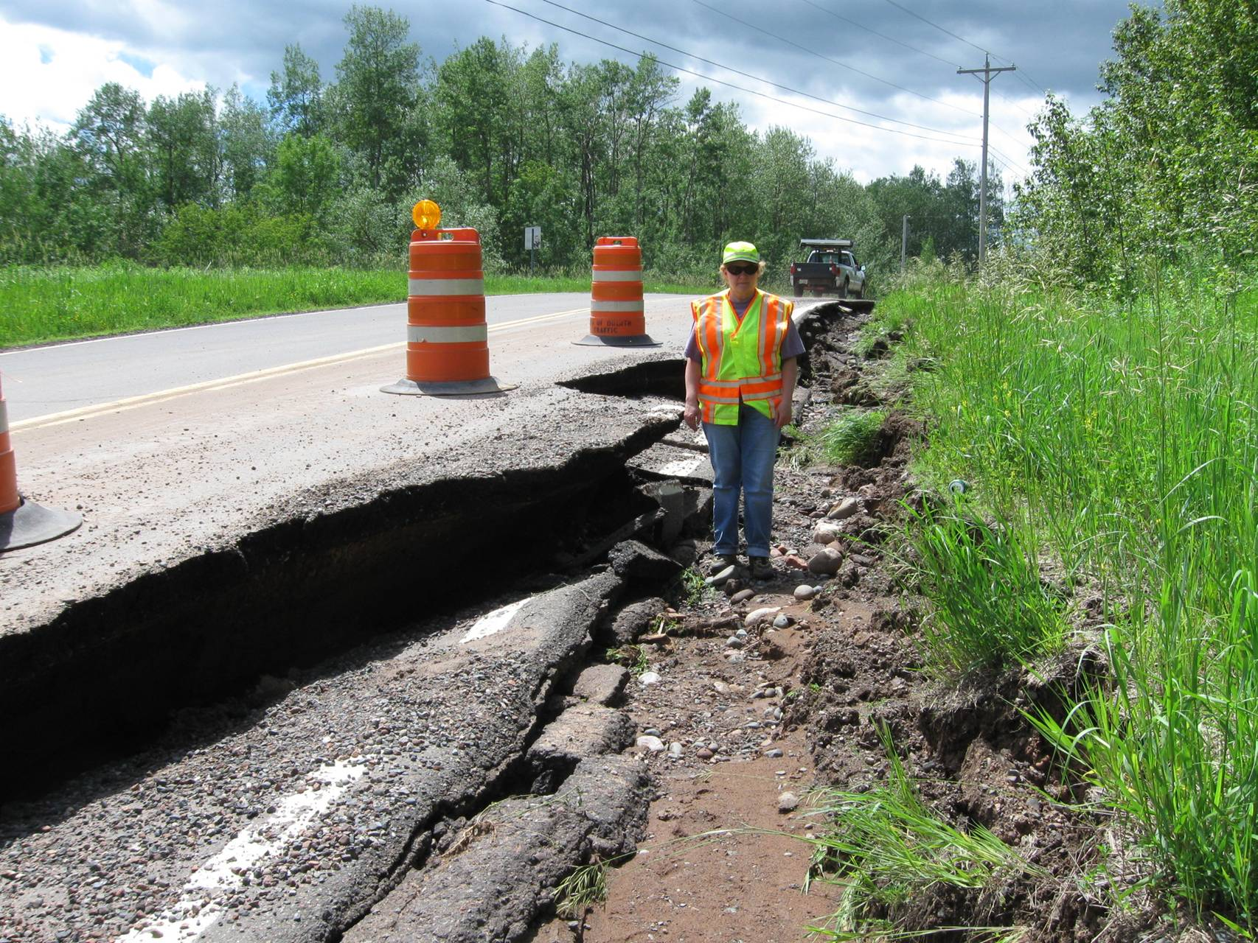
Initial Response
Work with Law Enforcement to Close Roads
26 Road Closures on Trunk Highway System
Begin Damage Assessments
$50 Million in Damage to Trunk Highway System

Slide 6
Resources
MnDOT
DNR, DPS
Local Law Enforcement
FHWA
Emergency contracting authority, consultants and contractors
Mutual Aid

Slide 7
MnDOT Damage Repair
MnDOT Forces
  Focus on reopening roads and making them safe for travel
  Set and remove road closure signing
  Have presence at road closures when necessary
  Replace washed out culverts
  Remove debris
  Fill in eroded areas
  Perform damage assessments

Slide 8
MnDOT Damage Repair
Contract Work
  Focus on repairs beyond the capability of MnDOT resources
  Bridges, box culverts, road grades and pavement
  Clear debris
  Set long-term detours that required significant signing
  Perform specific engineering designs
  Storm sewer inspection
  Soil stabilization
  Contract work to date exceeds $11 Million

Slide 9
MnDOT Major Damage Areas
Trunk Highway 210 in Jay Cooke
Trunk Highway 210 in Thomson
Trunk Highway 23 in Fond du Lac neighborhood
Trunk Highway 2 from Proctor to I-35

Slide 10
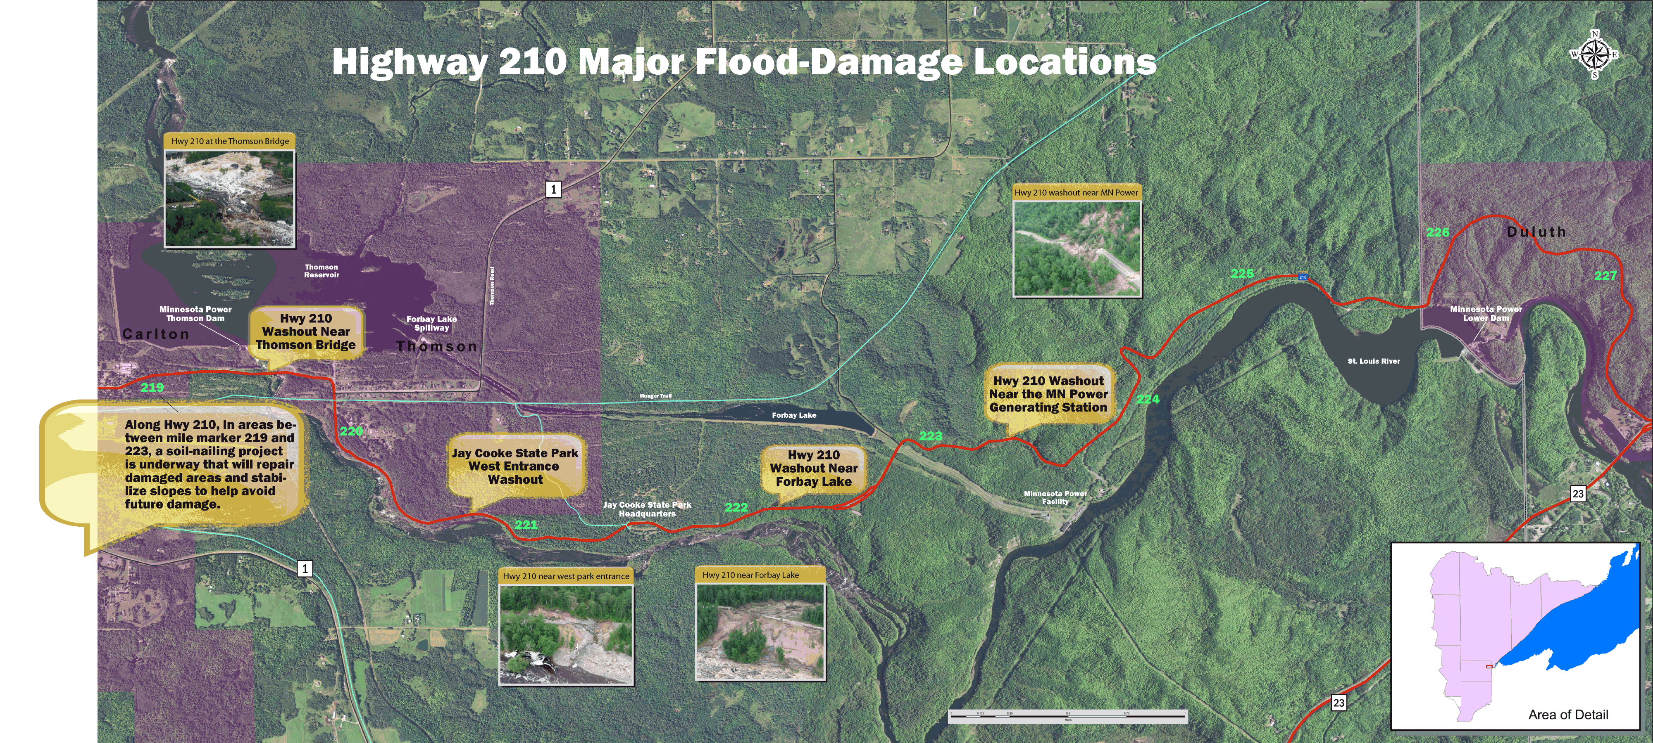
Trunk Highway 210 in Thomson to Trunk Highway 23

Slide 11
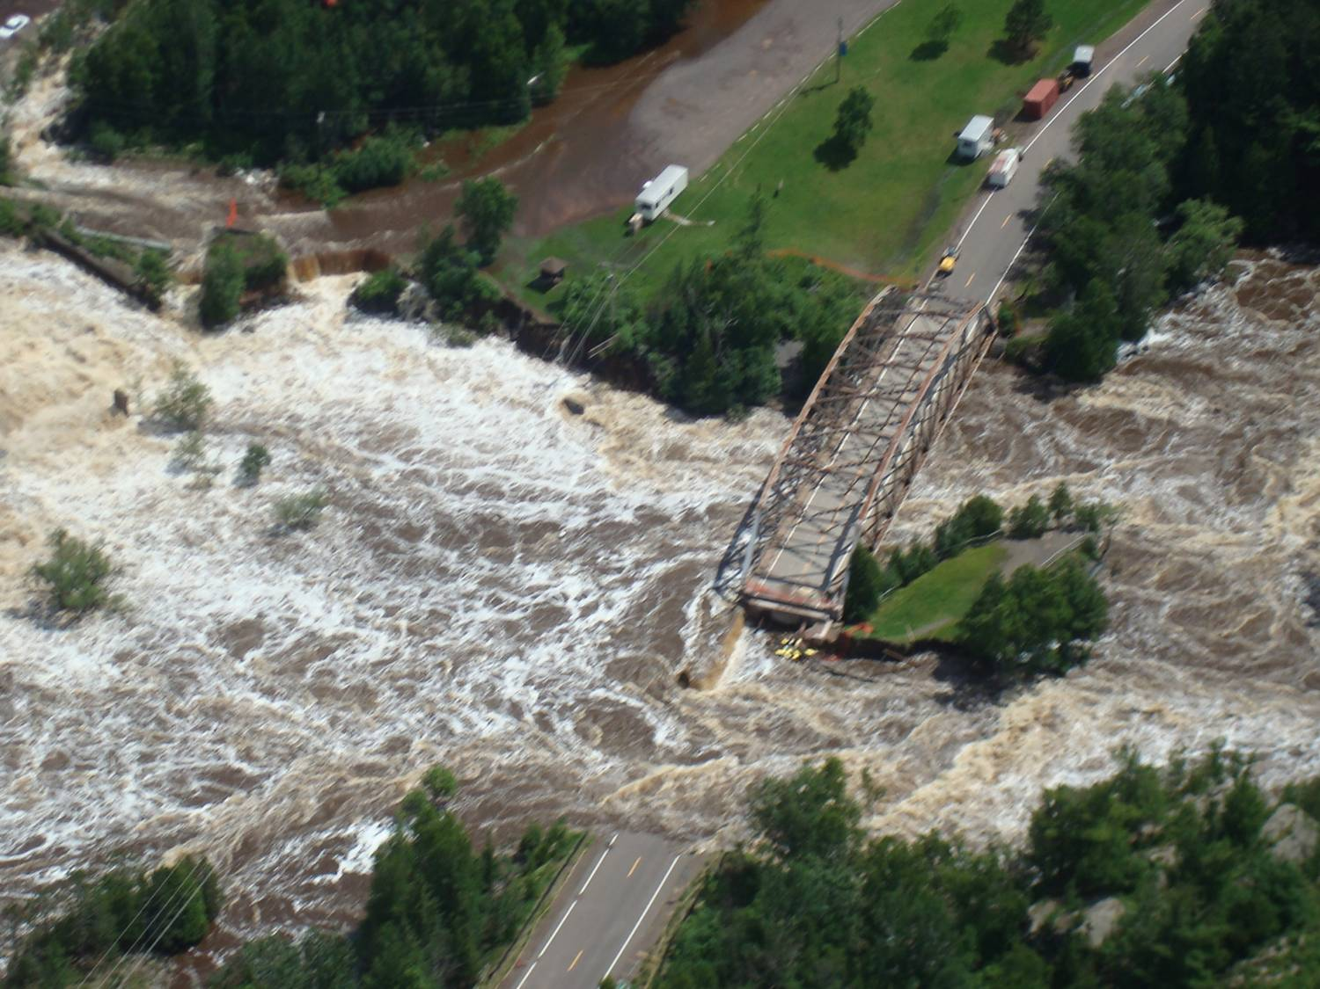
Trunk Highway 210 – Thomson

Slide 12
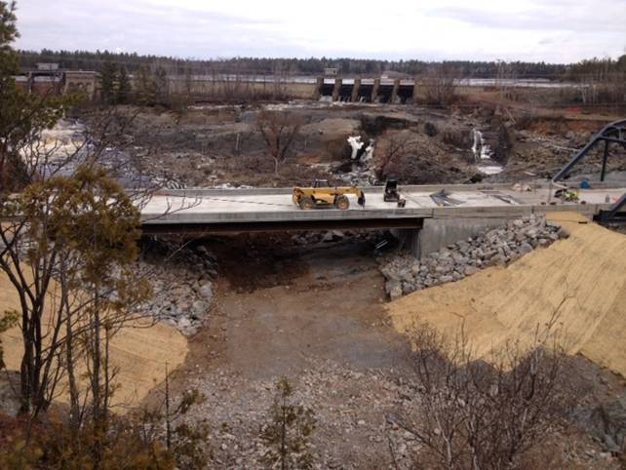
Trunk Highway 210 St. Louis River Bridge
$1.7 Million emergency repair contract with Northland Construction
Replace washed out 14’ diameter overflow pipe with 110’ long bridge
MnDOT supplies steel bridge beams

Slide 13
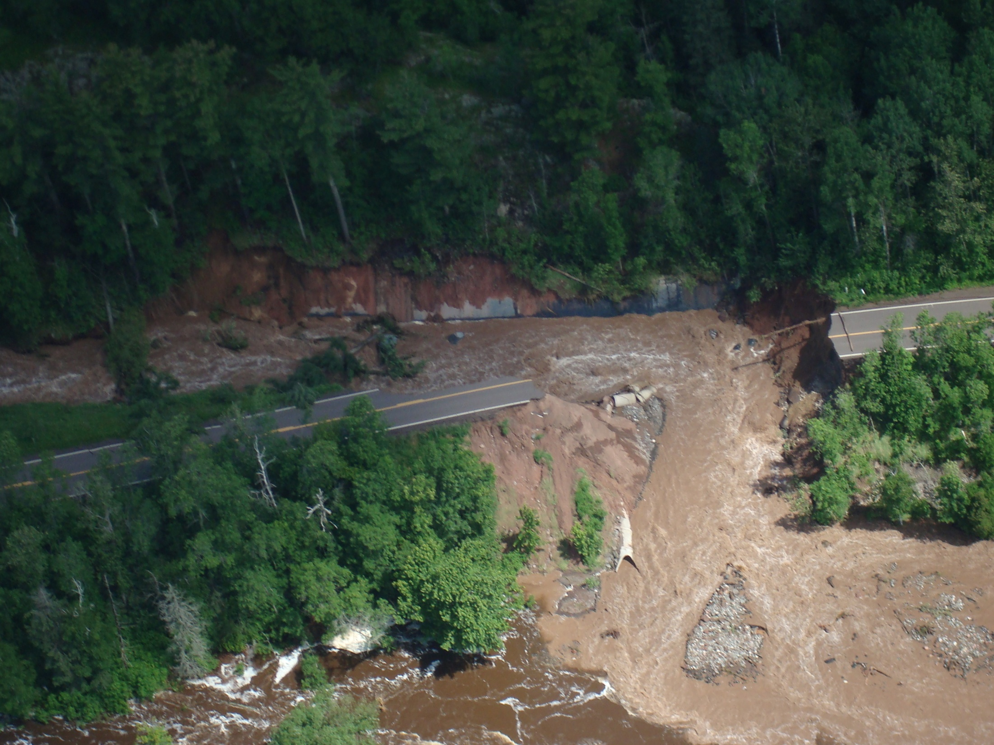
Trunk Highway 210 East Park Entrance
Jay Cooke

Slide 14
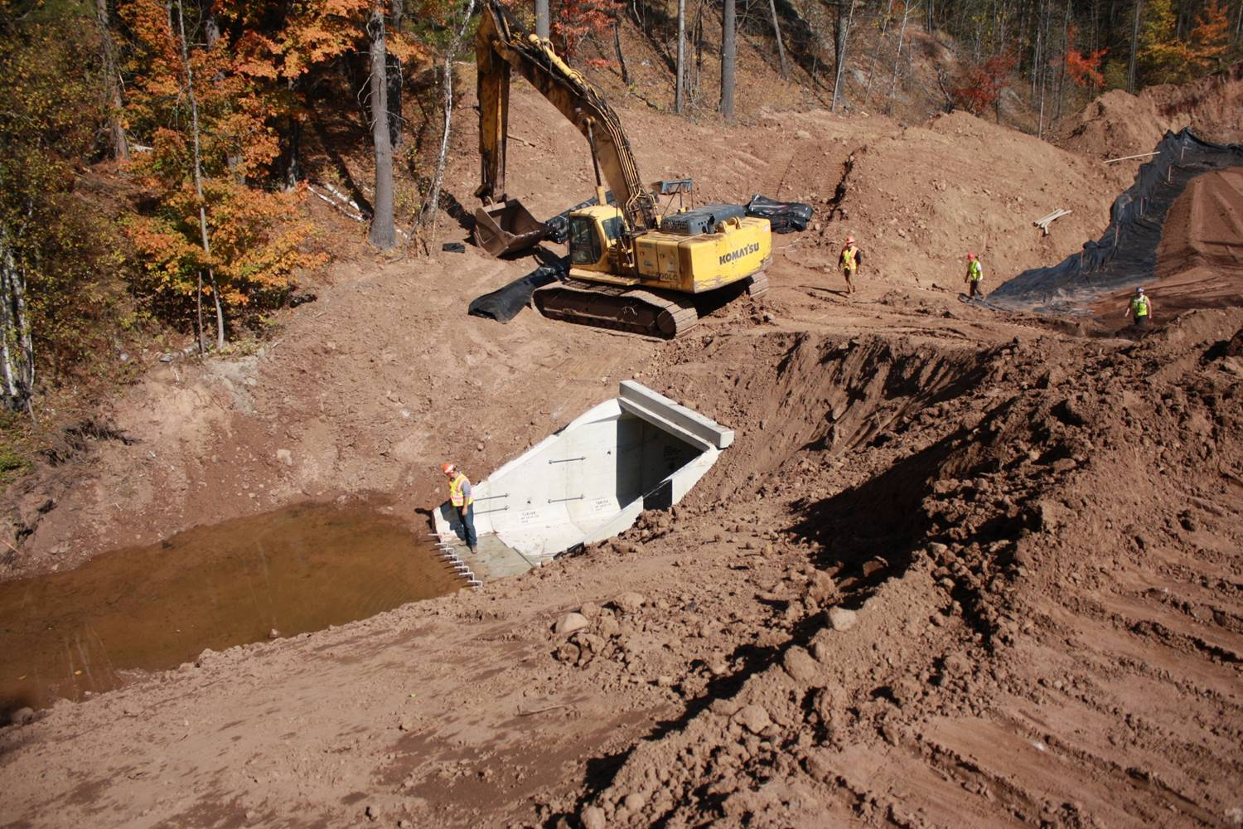
Trunk Highway 210—Thomson to Jay Cooke State Park River Lodge
$2.5 million emergency repair contracts with Ulland Brothers Construction, KGM Construction and Soil Nail Launchers
Stabilize slopes, install 8’ x 12’ x 250’ box culvert, replace small culverts, paving
Road reopened October 23, 2012

Slide 15
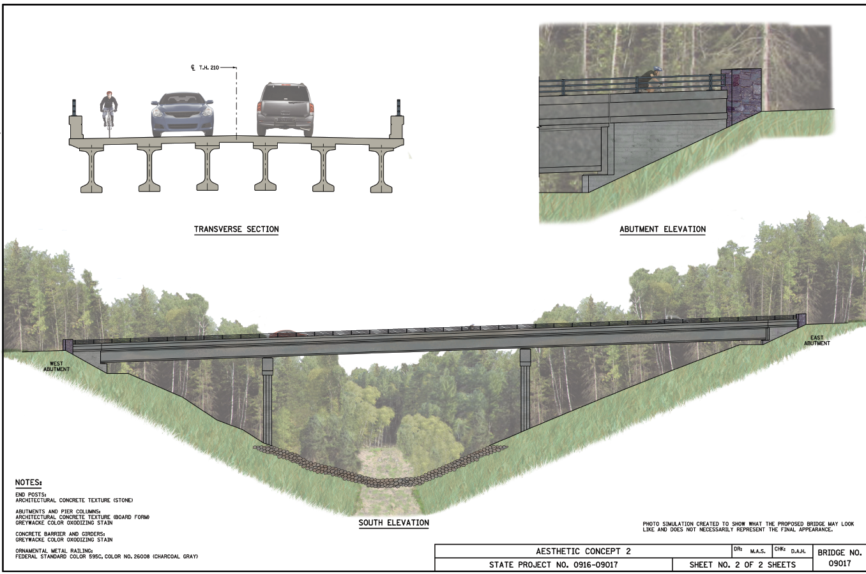
Trunk Highway 210 Forbay Reservoir - Jay Cooke State Park HQ to Jay Cooke Road
Realign roadway on more stable alignment
Significant environmental process
April 2013 letting
$2.8 Million contract - Redstone

Slide 16
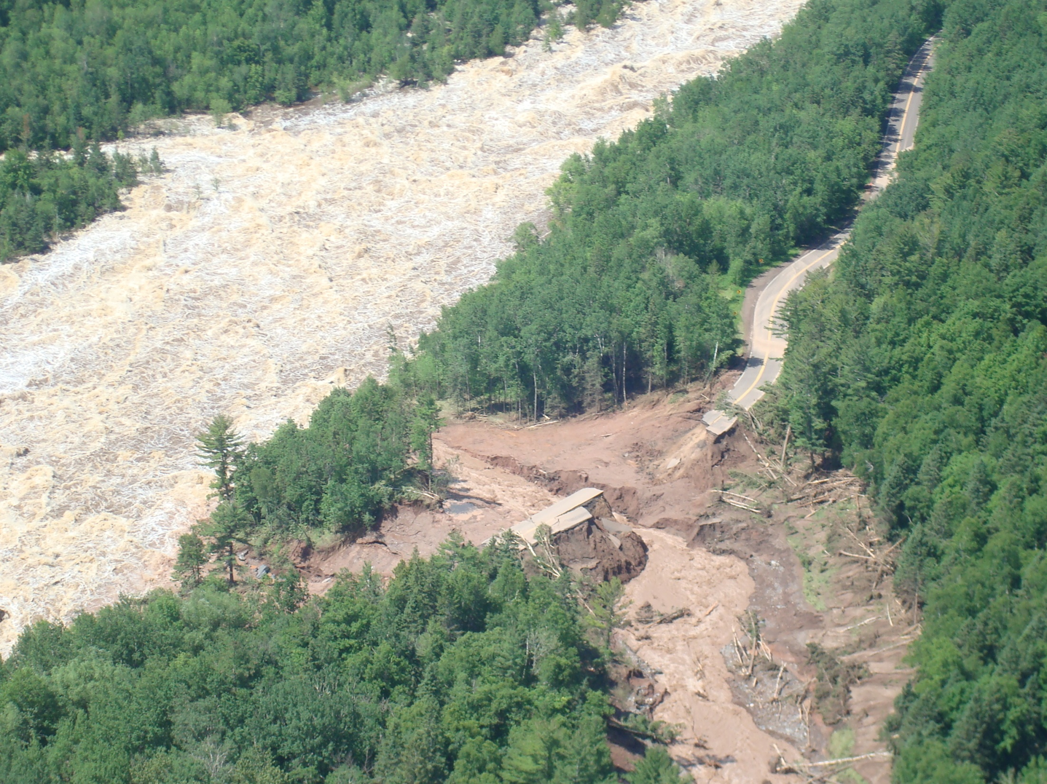
Trunk Highway 210 West of Power Canal—Jay Cooke

Slide 17
Trunk Highway 210—Jay Cooke Road to Trunk Highway 23
Critical access for Minnesota Power and Light facilities at Thomson and Fond du Lac
Approximately $3.2 million emergency repair contracts
Goal to provide road work through entire corridor and access to the MPL facilities
Significant environmental process to determine permanent solution with many options

Slide 18
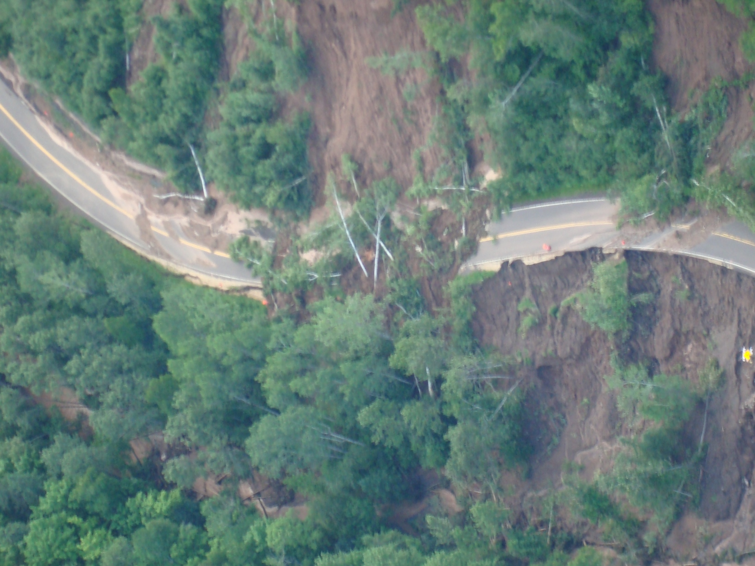
Trunk Highway 210 East of Power Canal—Jay Cooke

Slide 19
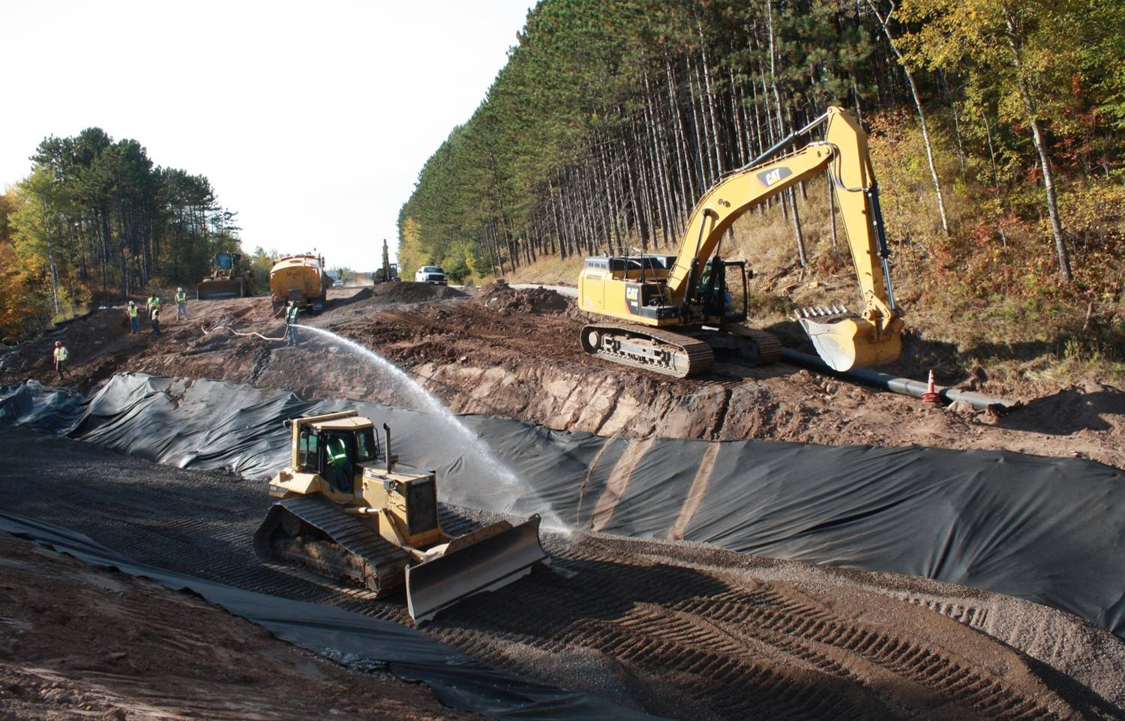
Trunk Highway 2—Proctor to Boundary Ave
$3.1 Million emergency repair contract with Schaffer Construction
½ mile grading and concrete pavement replacement
10’ X 16’ box culvert
Open November 8, 2012

Slide 20
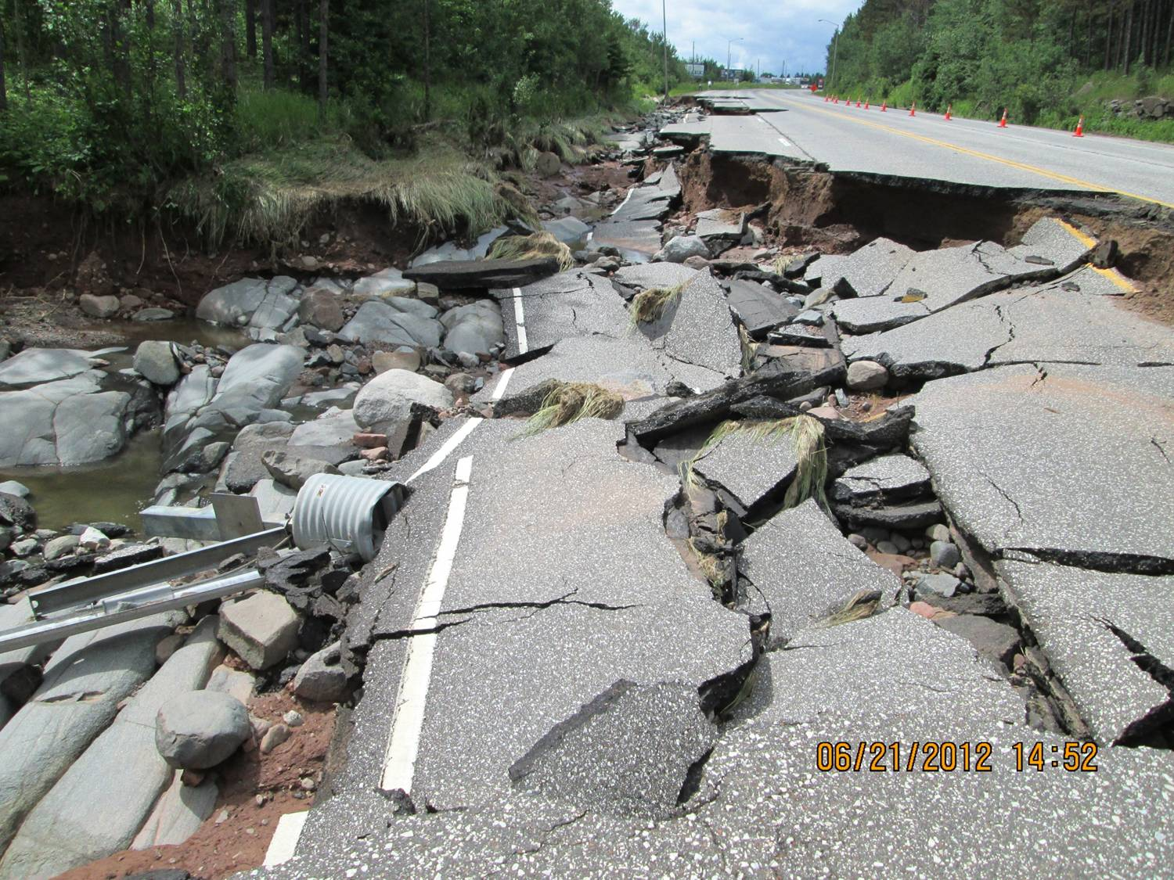
Hwy 2 and 35 Proctor
(near Duluth)

Slide 21
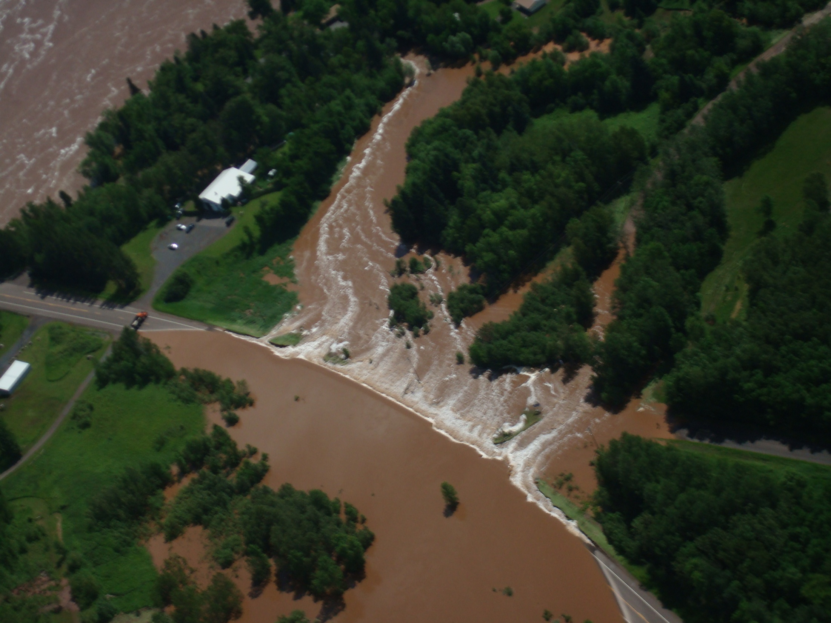
Trunk Highway 23 South of Bridge
Fond du Lac

Slide 22
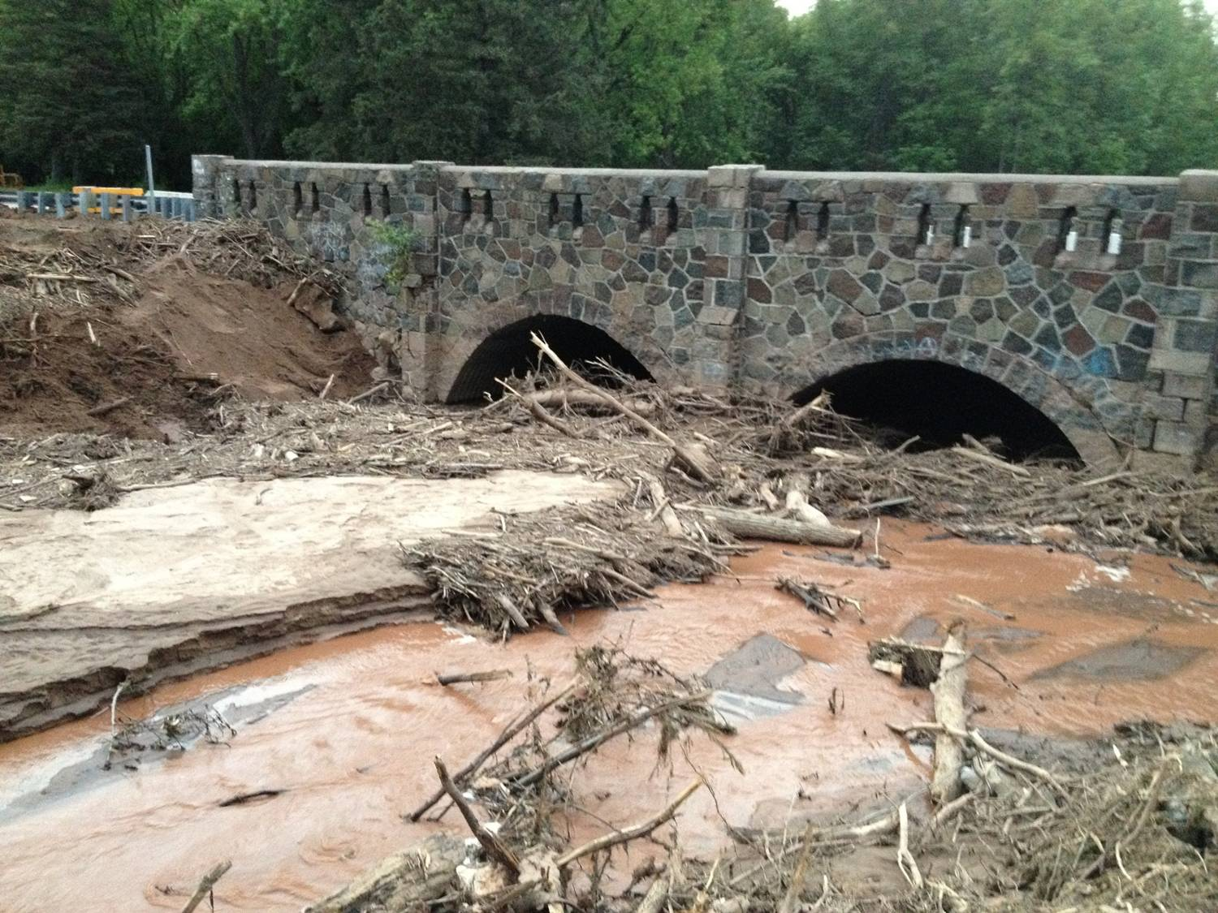
Future MnDOT Flood Projects
Trunk Highway 61 Replace Silver Creek Bridge
Trunk Highway 23 Replace Mission Creek Bridge in Fond du Lac

Slide 23
Local Agency Damage (Cities and Counties)
State Aid System
  Over 1,000 miles of local roads
  225 structures
  Local agency damage exceeds $1Billion
  2/3 of repairs planned for 2013
  1/3 will be completed in 2014

Slide 24
Local Agency Bridge Inspection Program
Special post-flood bridge inspection program
6 consultant teams managed by SEH
177 local bridges inspected by consultants
58 structures inspected by local agencies
Contract administered by St. Louis County, managed by MnDOT

Slide 25
Local Agency Damage – Bridge Inspection Program
58 local bridges will be replaced or need major rehabilitation - $22 Million
75 structures with minor damage –
$2.2 Million

